Slide 1
Electronic Circuit Design
Technology
Week 2-3
MOSFET Amplifiers

Slide 2
FET Types
p-channel
JFET
n-channel
FET
enhancement
p-channel
depletion
MOSFET
enhancement
n-channel
depletion

Slide 3
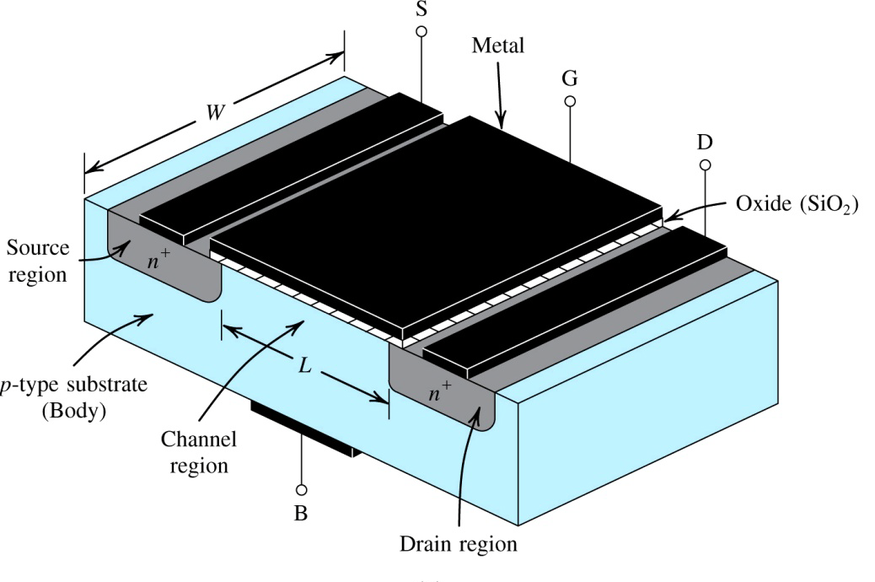
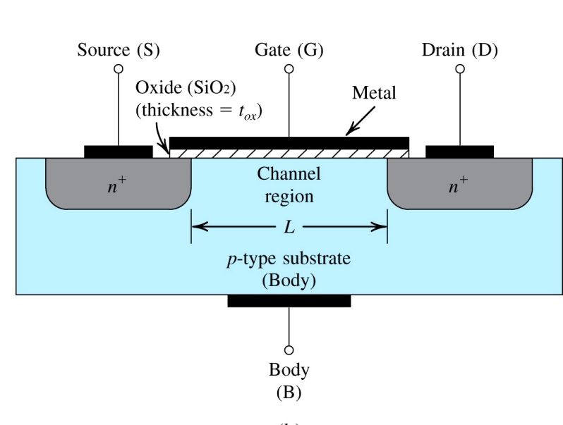
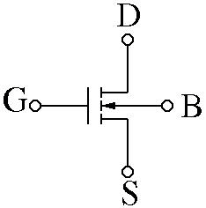
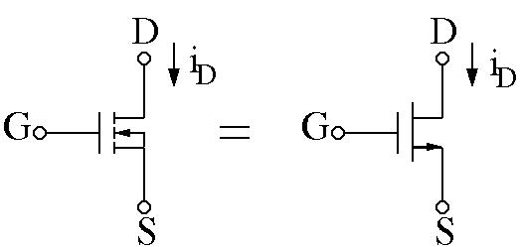
Enhancement Type n-channel MOSFET Structure

Slide 4
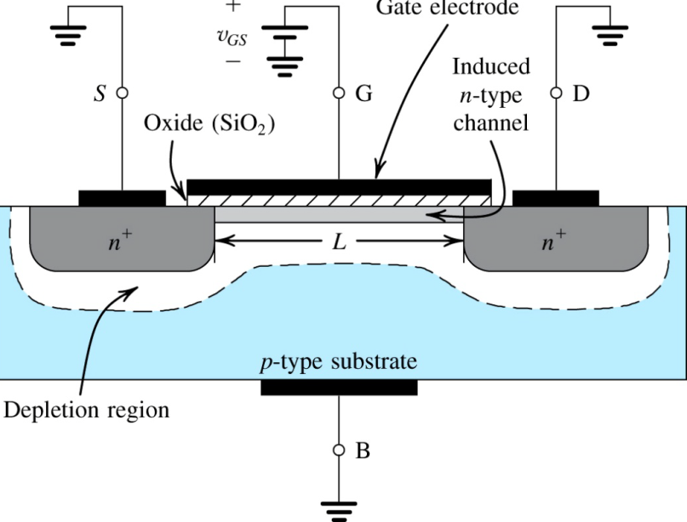
Applying gate volatge (VGS)
With no gate voltage Two back to back diodes
Applying VGS pushed down the holes and leave a depletion region populated by –ve charges associated with accepter atoms, attracts electrons from n+ source and drain regions n-channel inversion layer (p to n)
The value of VGS which accumulates sufficent electrons to form a channel is called threshold voltage (Vt)
Gate and body form a parallel plate capacitor, oxide layer acts as capacitor dielectric. Positive voltage on top plate accumulate –ve charges in channel

Slide 5
Small VGS
An NMOS transistor with v_{GS} < V_{t} The device acts as an open circuit.

Slide 6
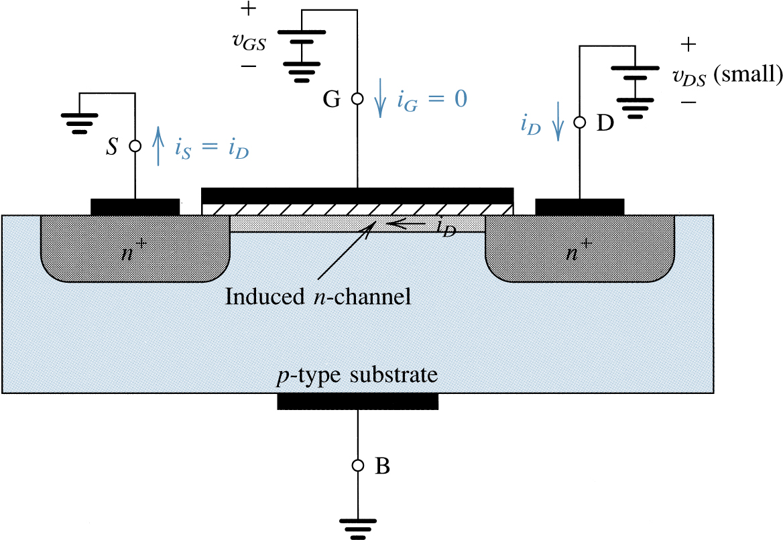
An NMOS transistor with v_{GS} > V_{t} and with a small v_{DS} applied. The device acts as a resistor whose value is determined by v_{GS}. Specifically, the channel resistance is proportional to v_{GS} - V_{t}, and this i_{D} is proportional to (v_{GS} - Vt) v_{DS}.

Slide 7
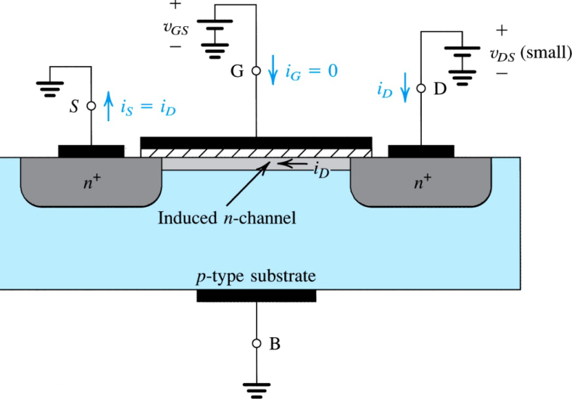
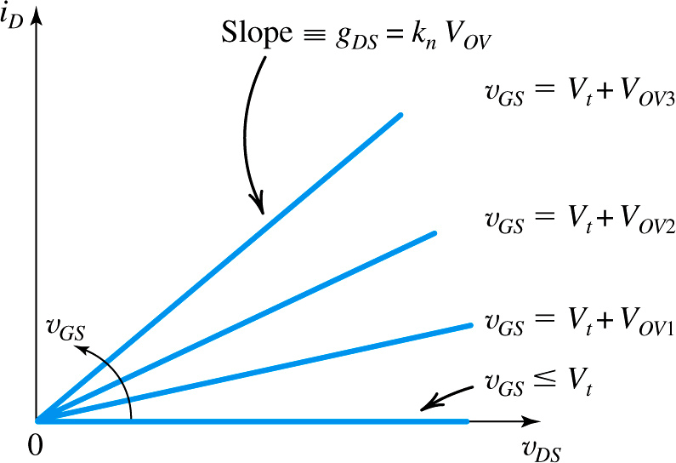
Applying small VDS
Effective gate voltage (VGS-Vt) increase in channel conductance or depth
MOSFET operates as linear resistor,
which is controlled by VGS,
resistance is infinite for VGS ≤ Vt

Slide 8
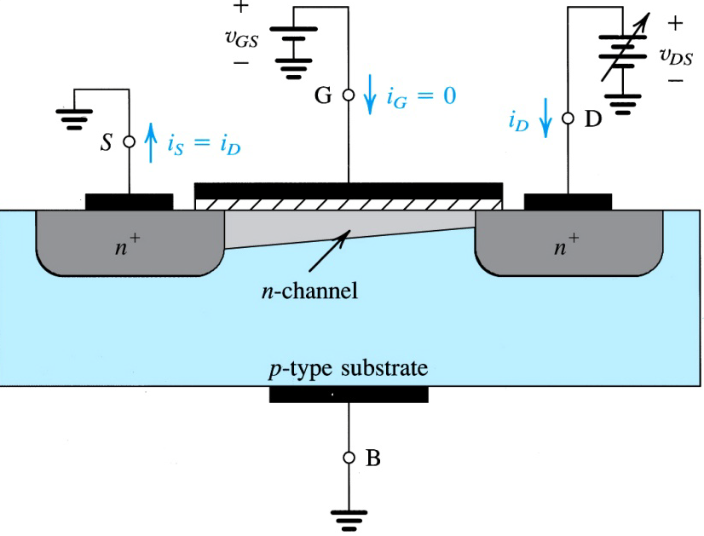
VDS is increased
From source to drain voltage increases from 0 ~ VDS
Voltage decreases along the channel from VGS to VGS-VDS
The channel depth depends on this voltage, channel is not uniform rather tapered
Operation of the enhancement NMOS transistor as v_{DS} is increased. The induced channel acquires a tapered shape and its resistance increases as v_{DS} is increased. Here, v_{GS} is kept constant at a value > V_{t}.

Slide 9
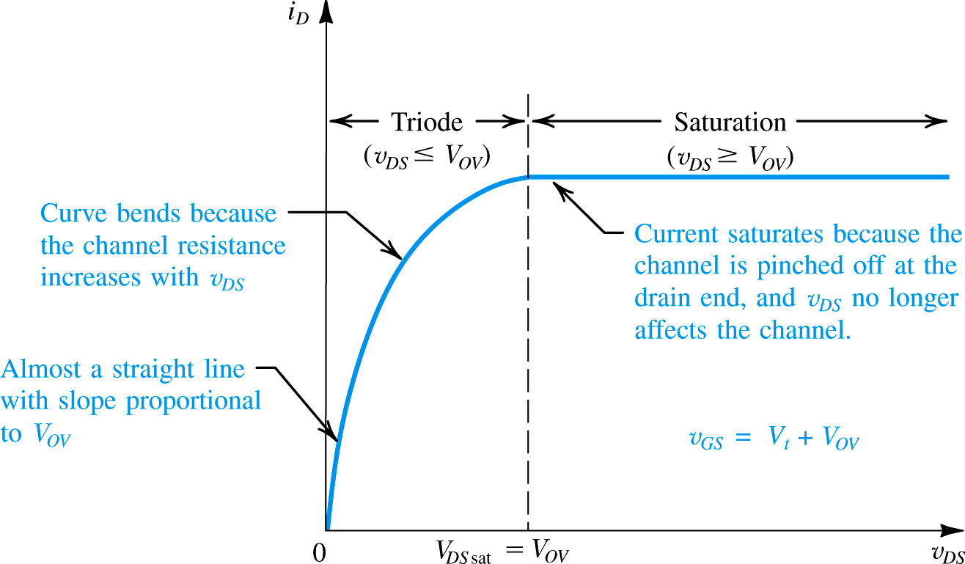
ID VS VDS with VGS > Vt

Slide 10
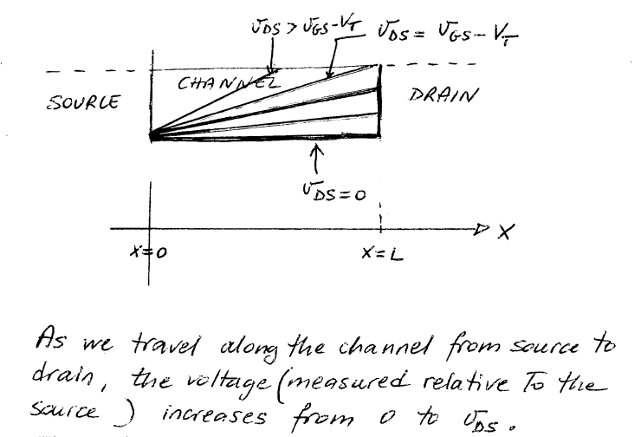
Derivation of the i_{D} vs. v_{DS} characteristic

Slide 11
nMOS equations

Slide 12
nMOS equation

Slide 13
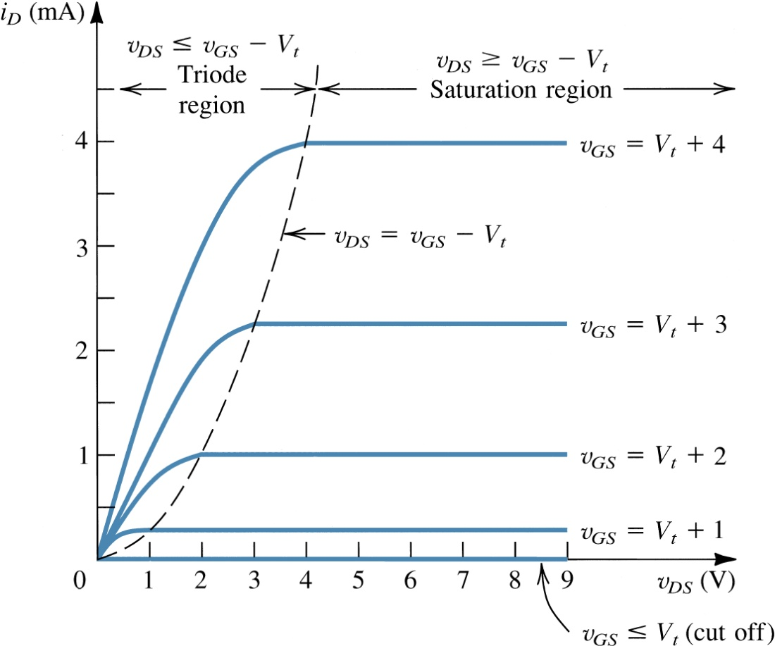
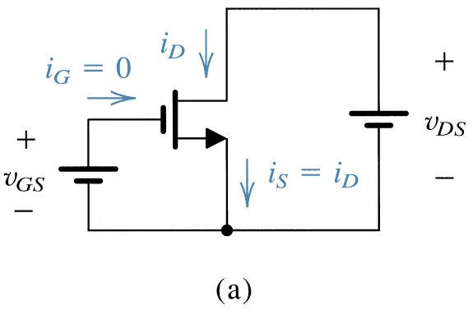
Transfer characteristics of p-Channel enhancement type MOSFET
An n-channel enhancement-type MOSFET with v_{GS} and v_{DS} applied and with the normal directions of current flow indicated.
The i_{D} - v_{DS} characteristics for a device with V_{t} = 1 V and k’_{n}(W/L) = 0.5 mA/V².

Slide 14
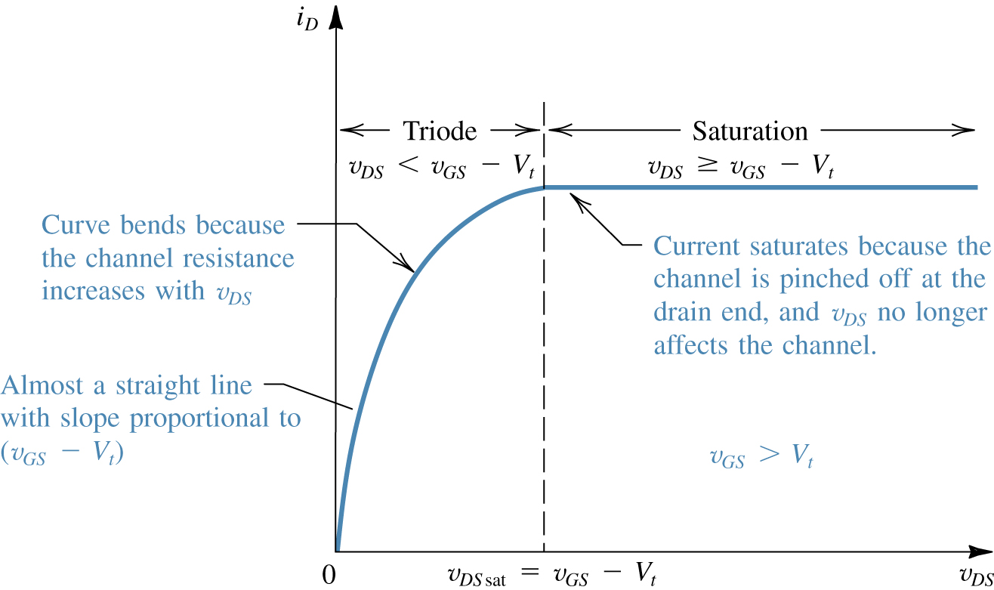
Zooming in the output characteristics
The drain current i_{D} versus the drain-to-source voltage v_{DS} for an enhancement-type NMOS transistor operated with v_{GS} > V_{t}.

Slide 15
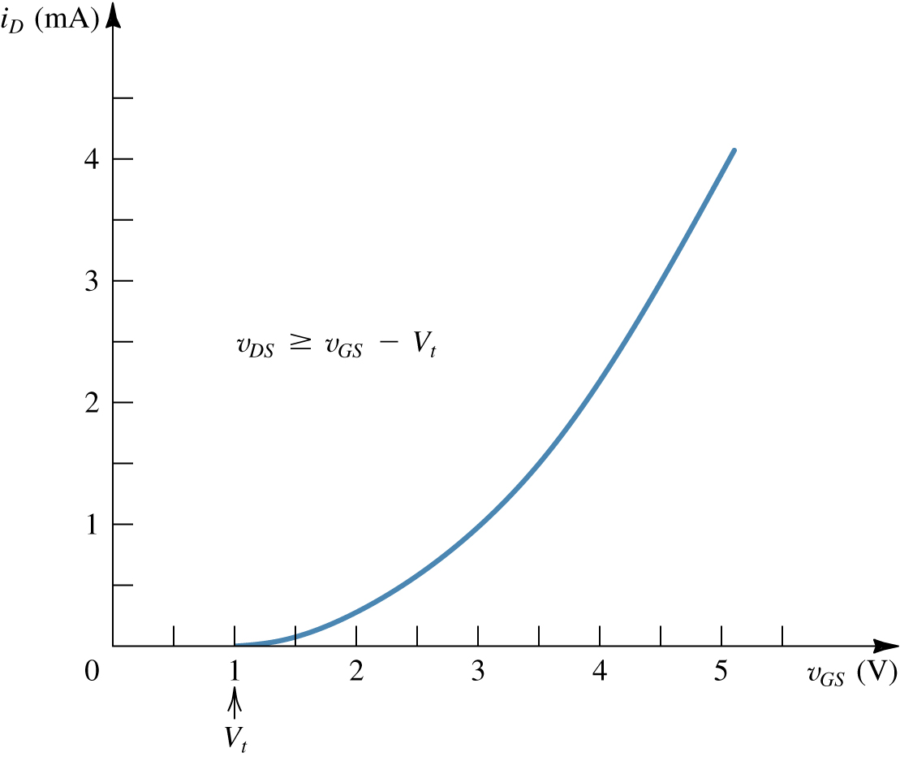
nMOS in saturation: i_{D} vs. v_{GS}
The i_{D} - v_{GS} characteristic for an enhancement-type NMOS transistor in saturation (V_{t} = 1 V and k_{n}= 0.5 mA/V²).
Drain current is independent on the VDS.
Ids only depends on Vgs and follows square law of FET.

Slide 16
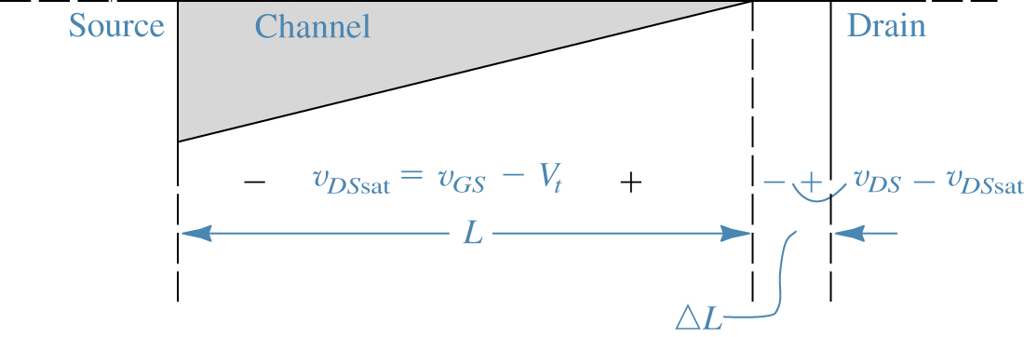
channel length modulation
Increasing v_{DS} beyond v_{DSsat} causes the channel pinch-off point to move slightly away from the drain, thus reducing the effective channel length (by ΔL).

Slide 17
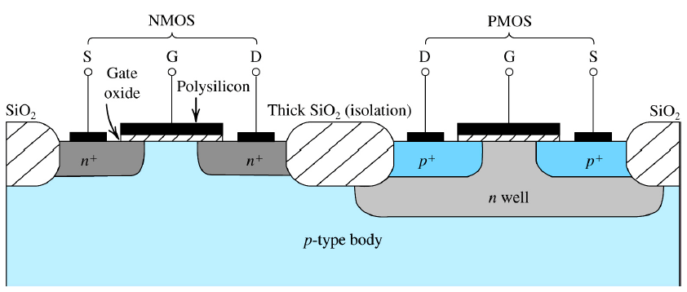
Complementary MOS or CMOS

Slide 18
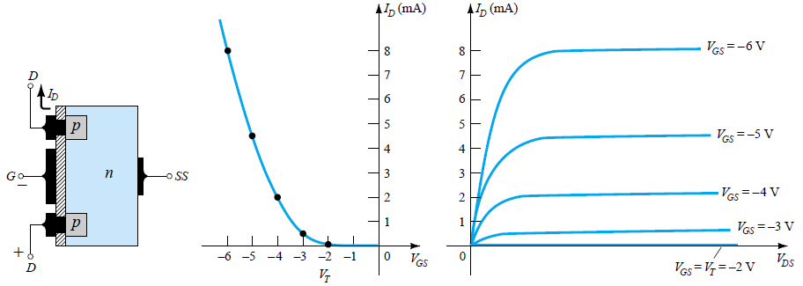

Transfer characteristics of p-Channel enhancement type MOSFET

Slide 19
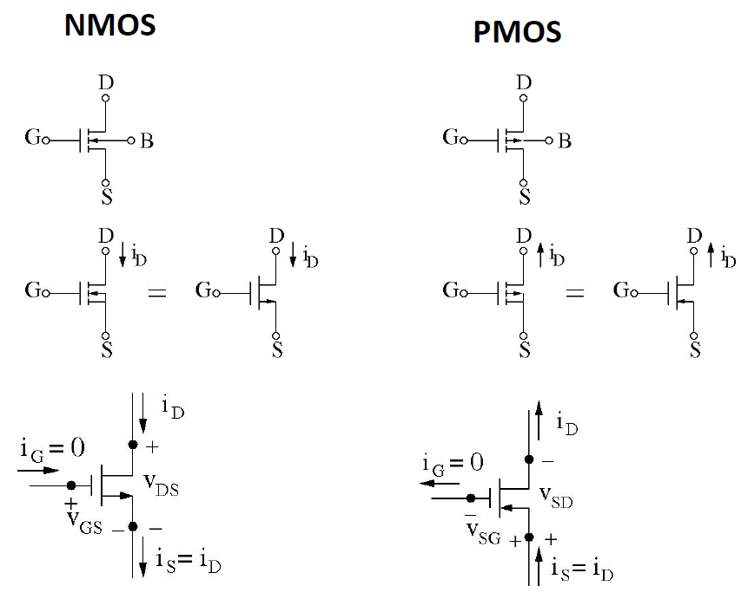
Symbols

Slide 20
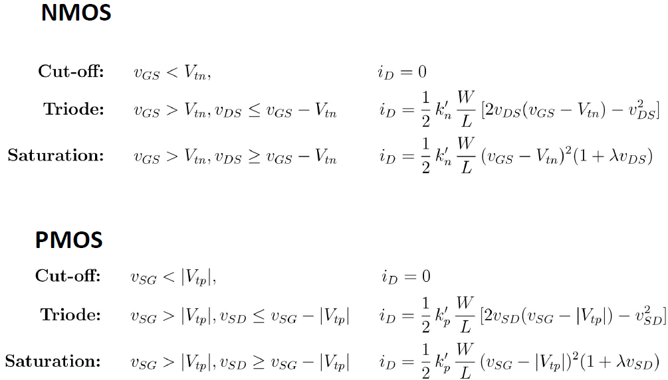
Equations

Slide 21
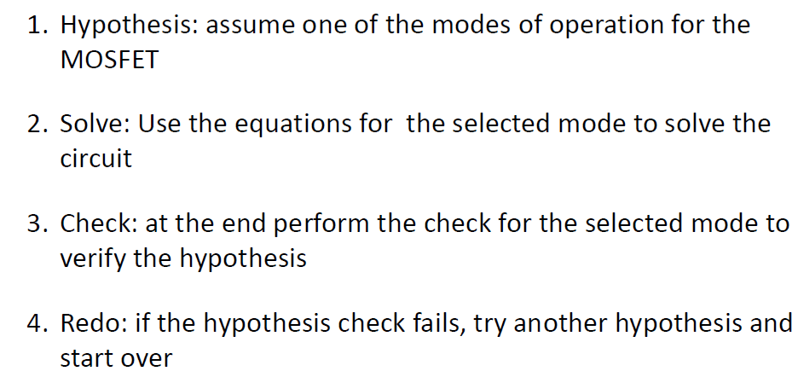
How to solve MOS circuit

Slide 22
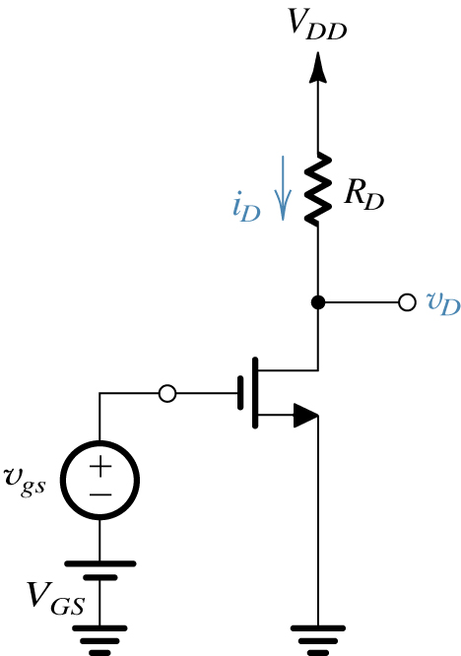
Small Signal Analysis
Conceptual circuit utilized to study the operation of the MOSFET as an amplifier.

Slide 23
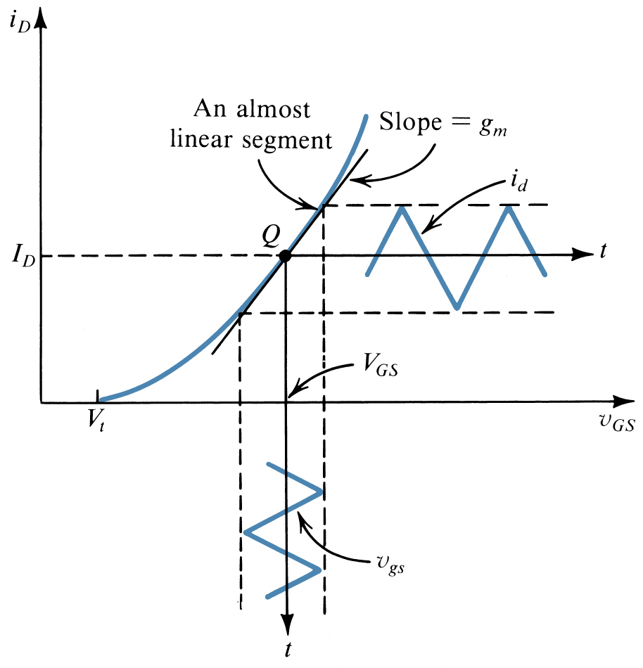
Small Signal Analysis
Small-signal operation of the enhancement MOSFET amplifier.

Slide 24
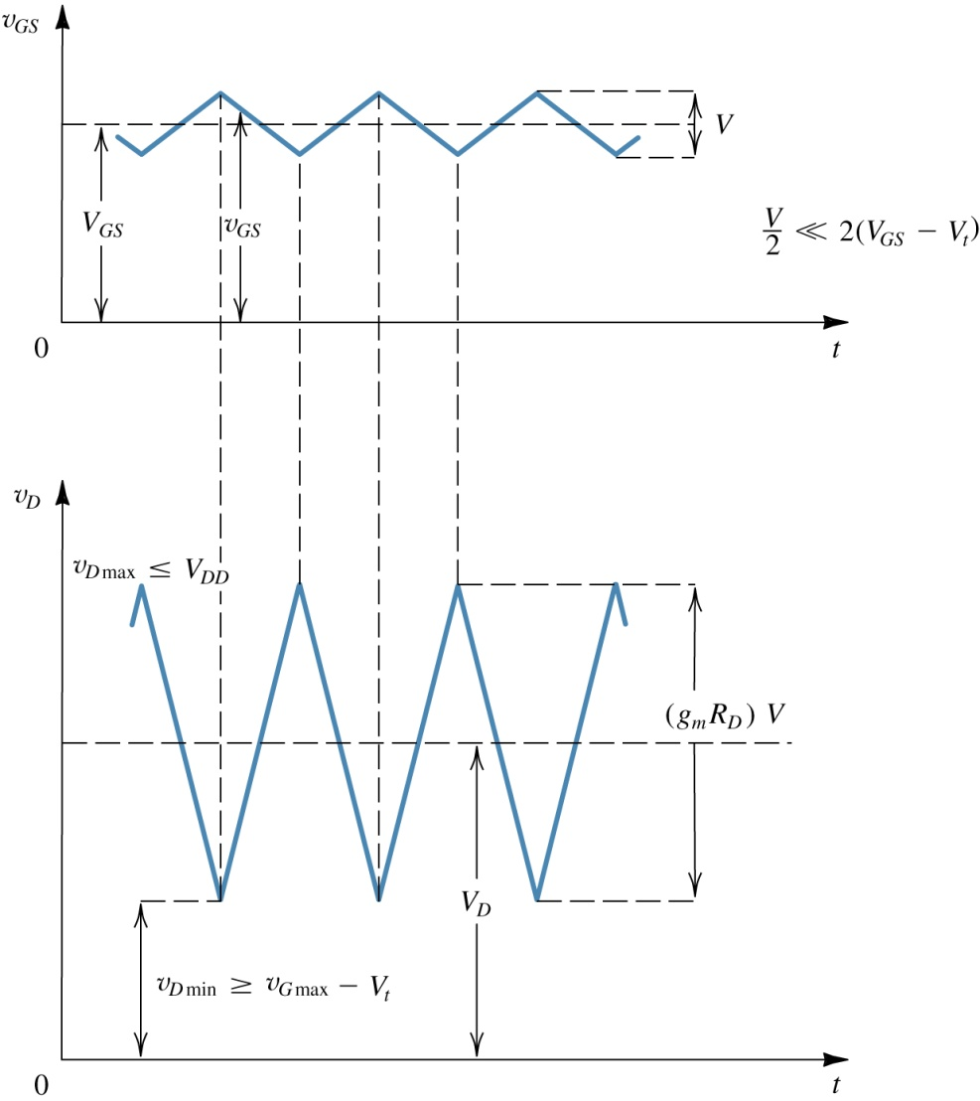
Total Component Analysis (DC + AC)
Total instantaneous voltages v_{GS} and v_{D}.

Slide 25
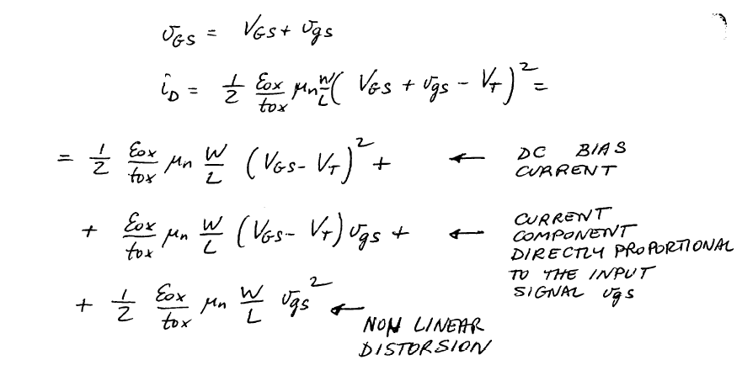
Total component Analysis

Slide 26
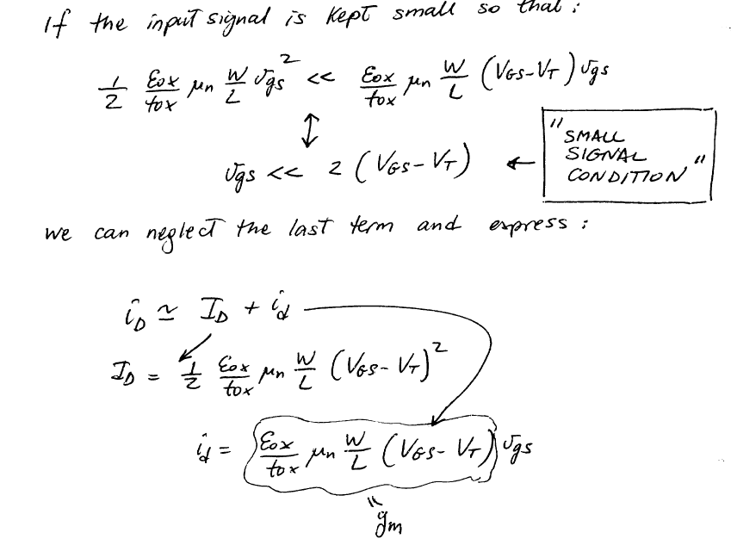
Total component Analysis

Slide 28
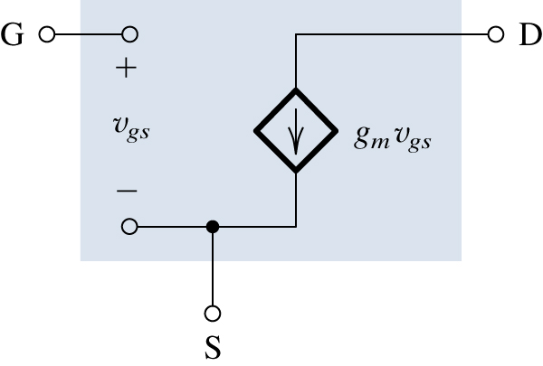
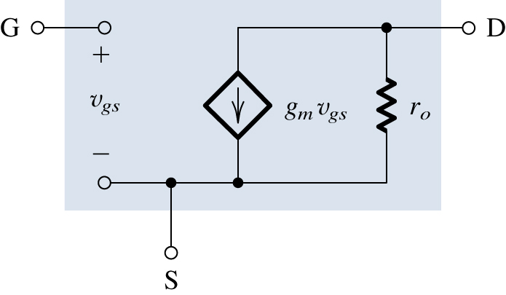
Small Signal Model
Small-signal models for the MOSFET: (a) neglecting the dependence of i_{D} on v_{DS} in saturation (channel-length modulation effect); and (b) including the effect of channel-length modulation modeled by output resistance r_{o} = |V_{A}|/I_{D}.

Slide 29

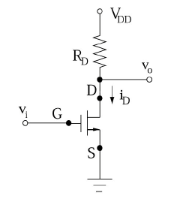
Problem 1

Slide 30
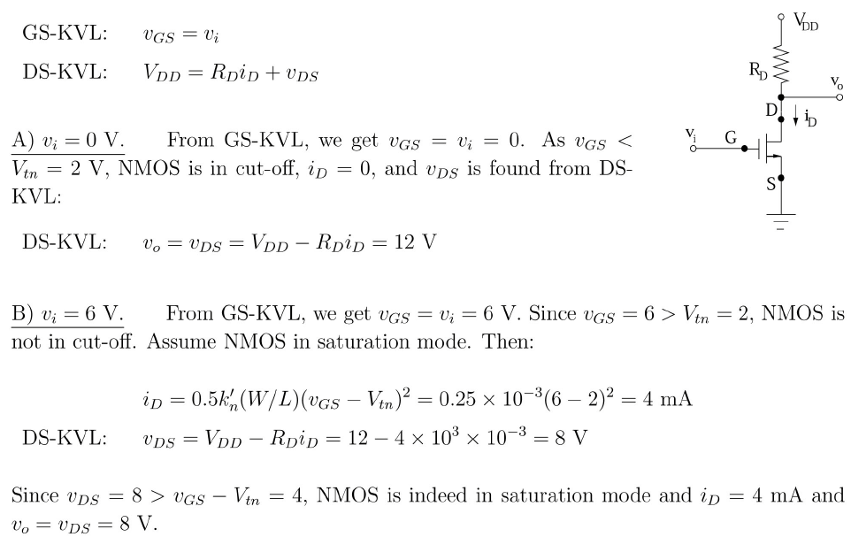

Slide 31
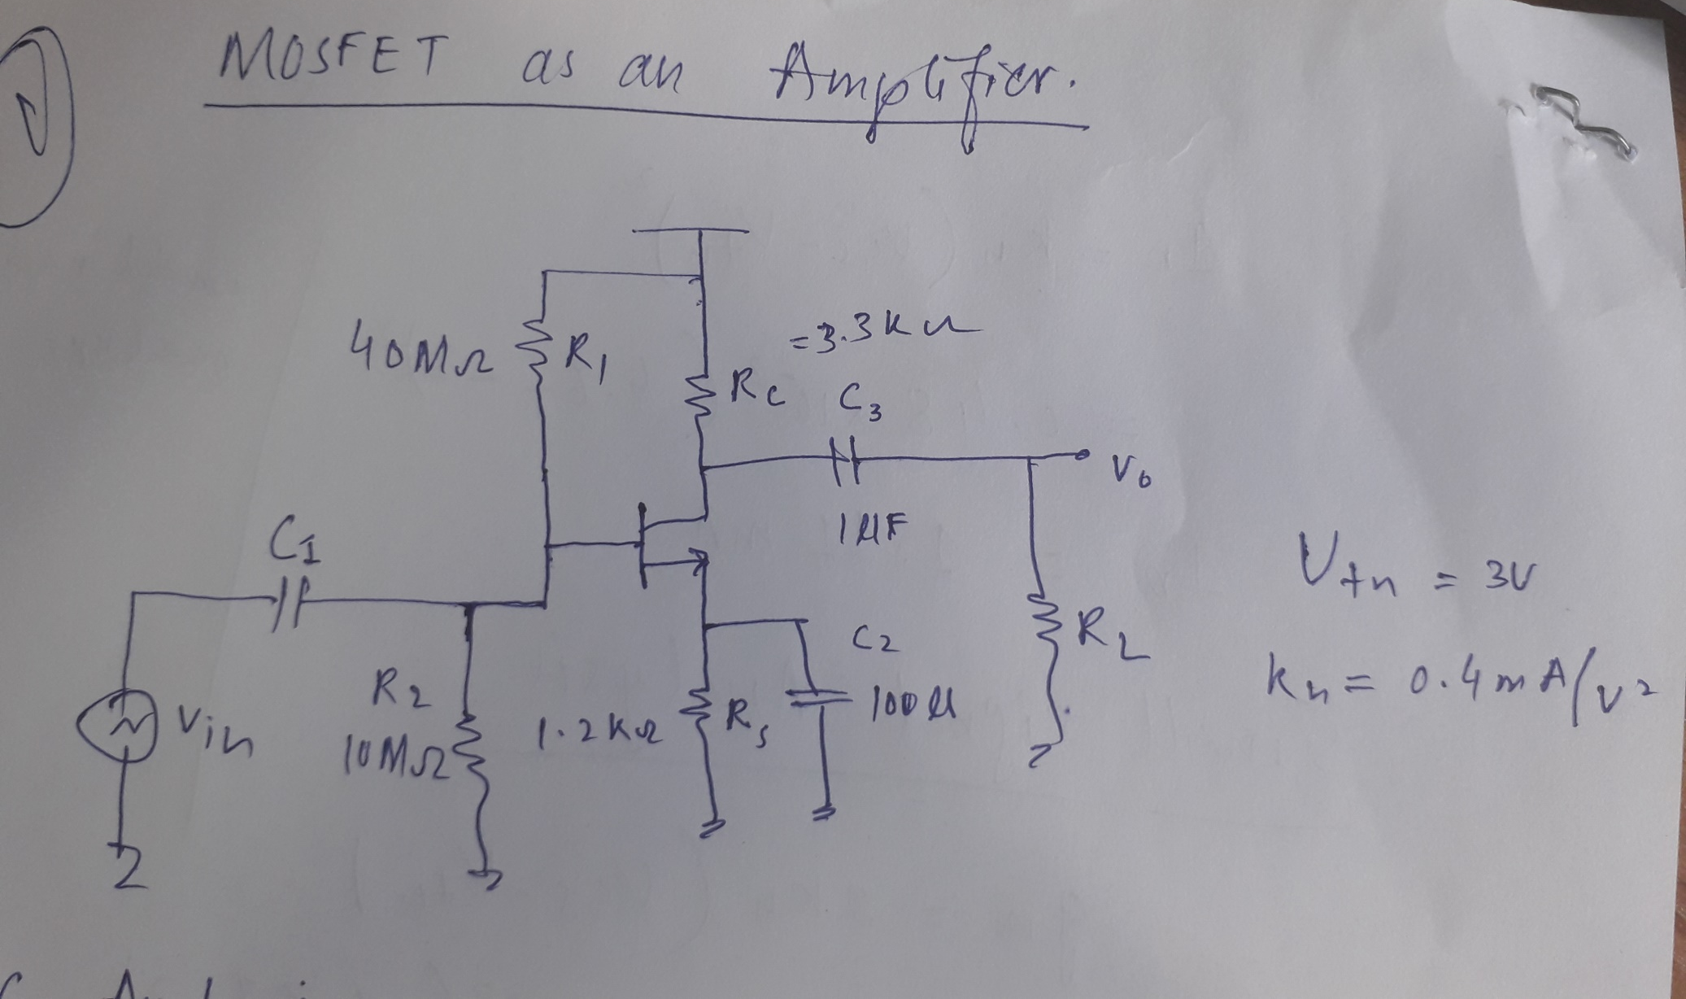

Slide 32
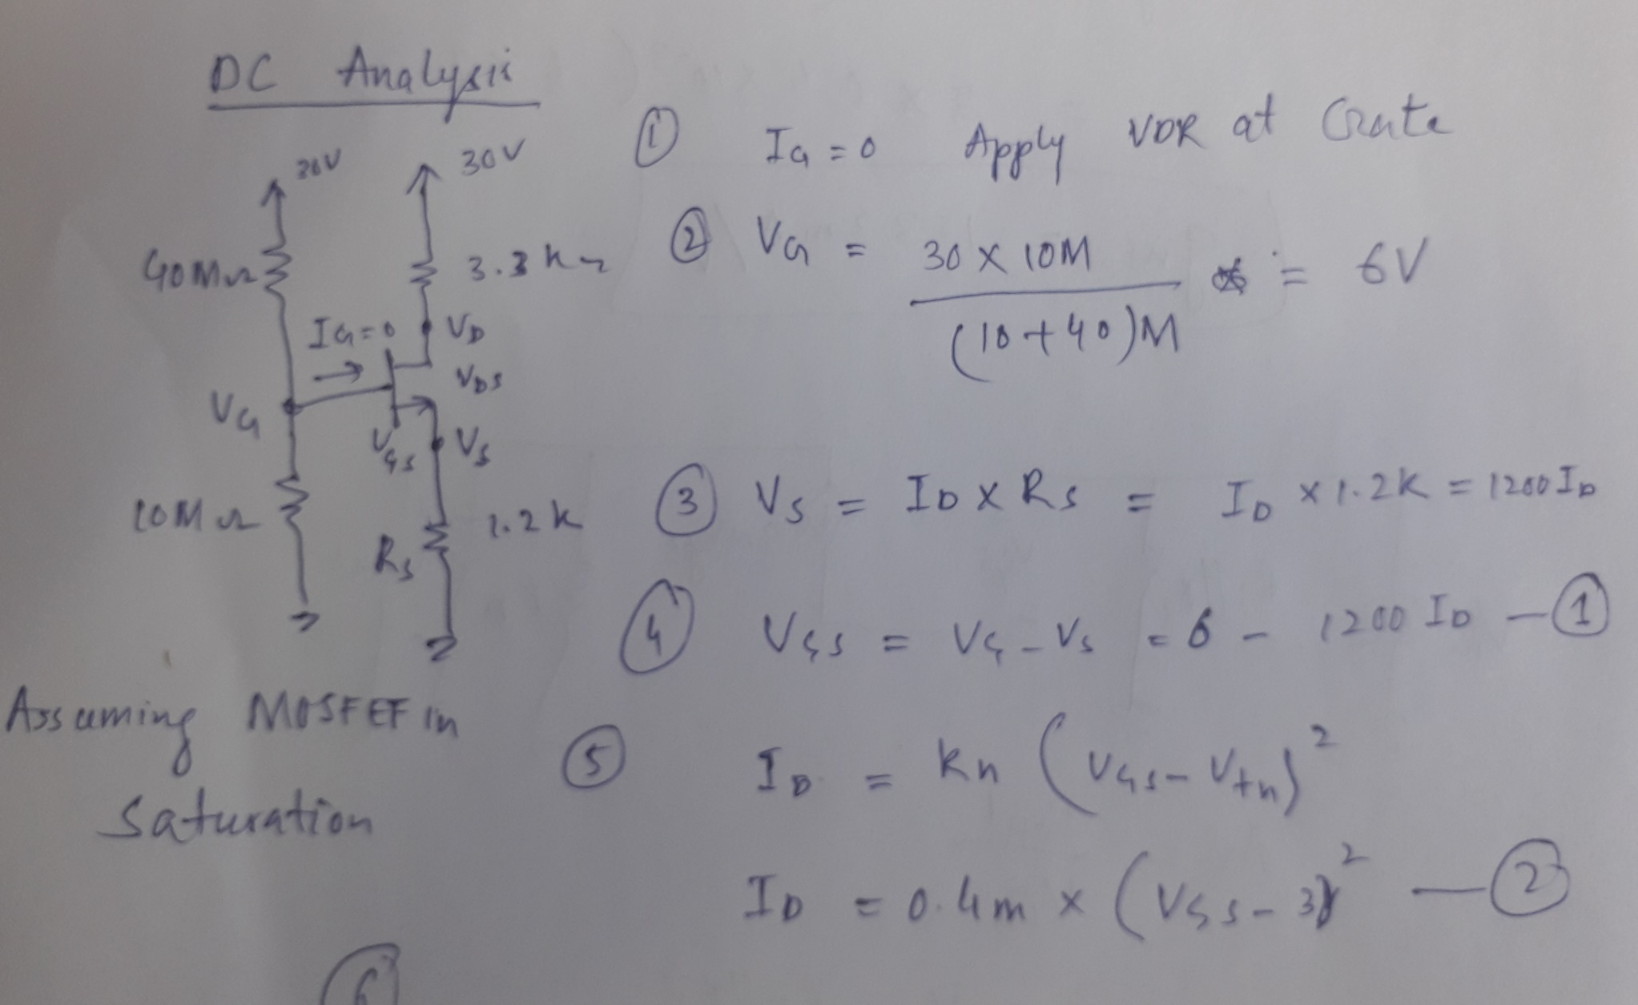

Slide 33
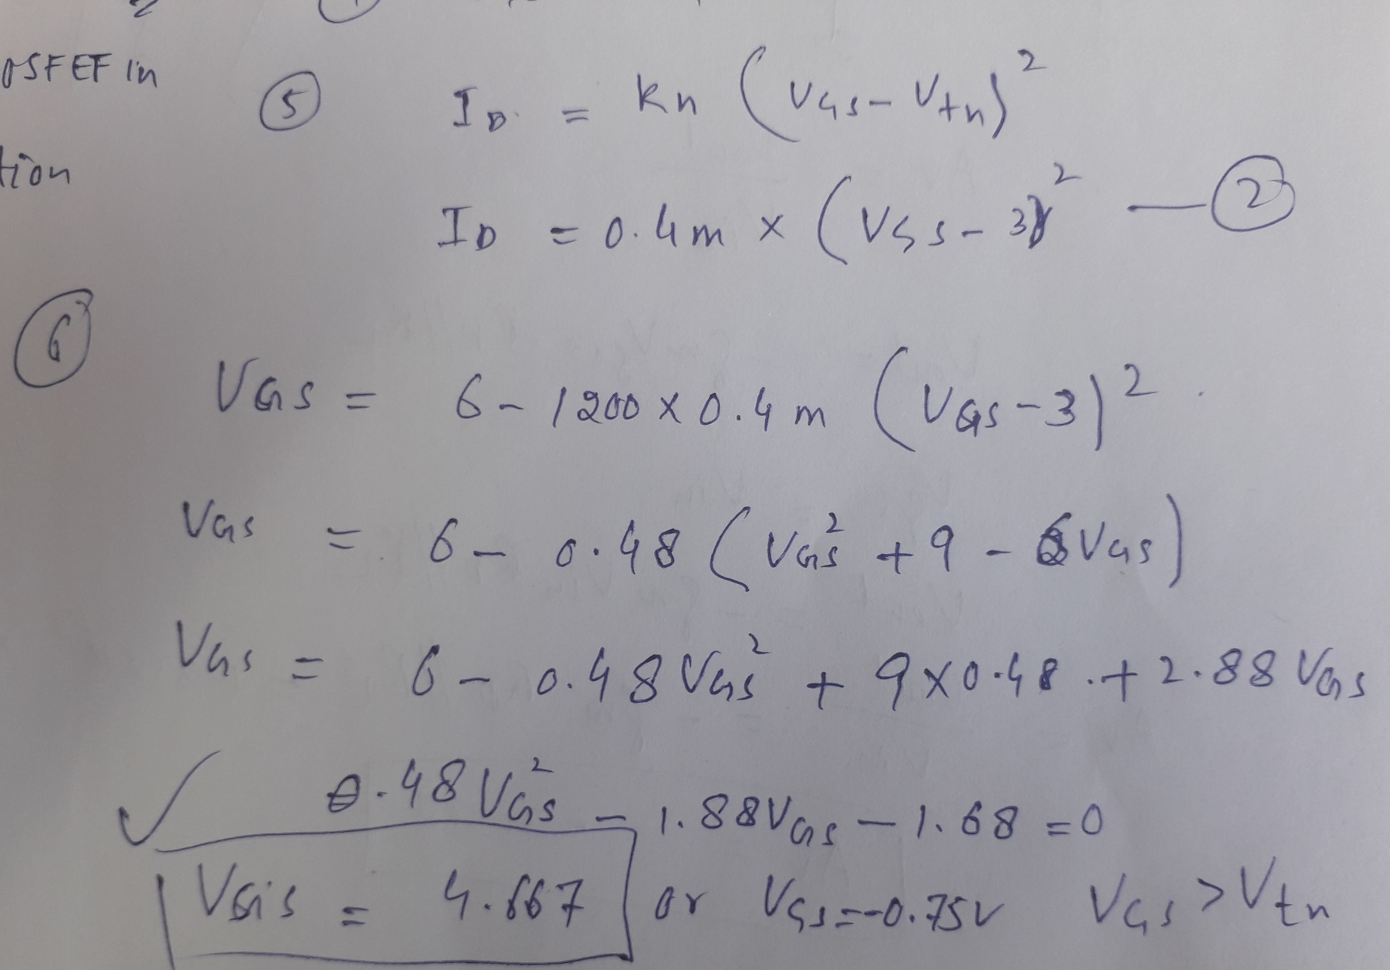

Slide 34
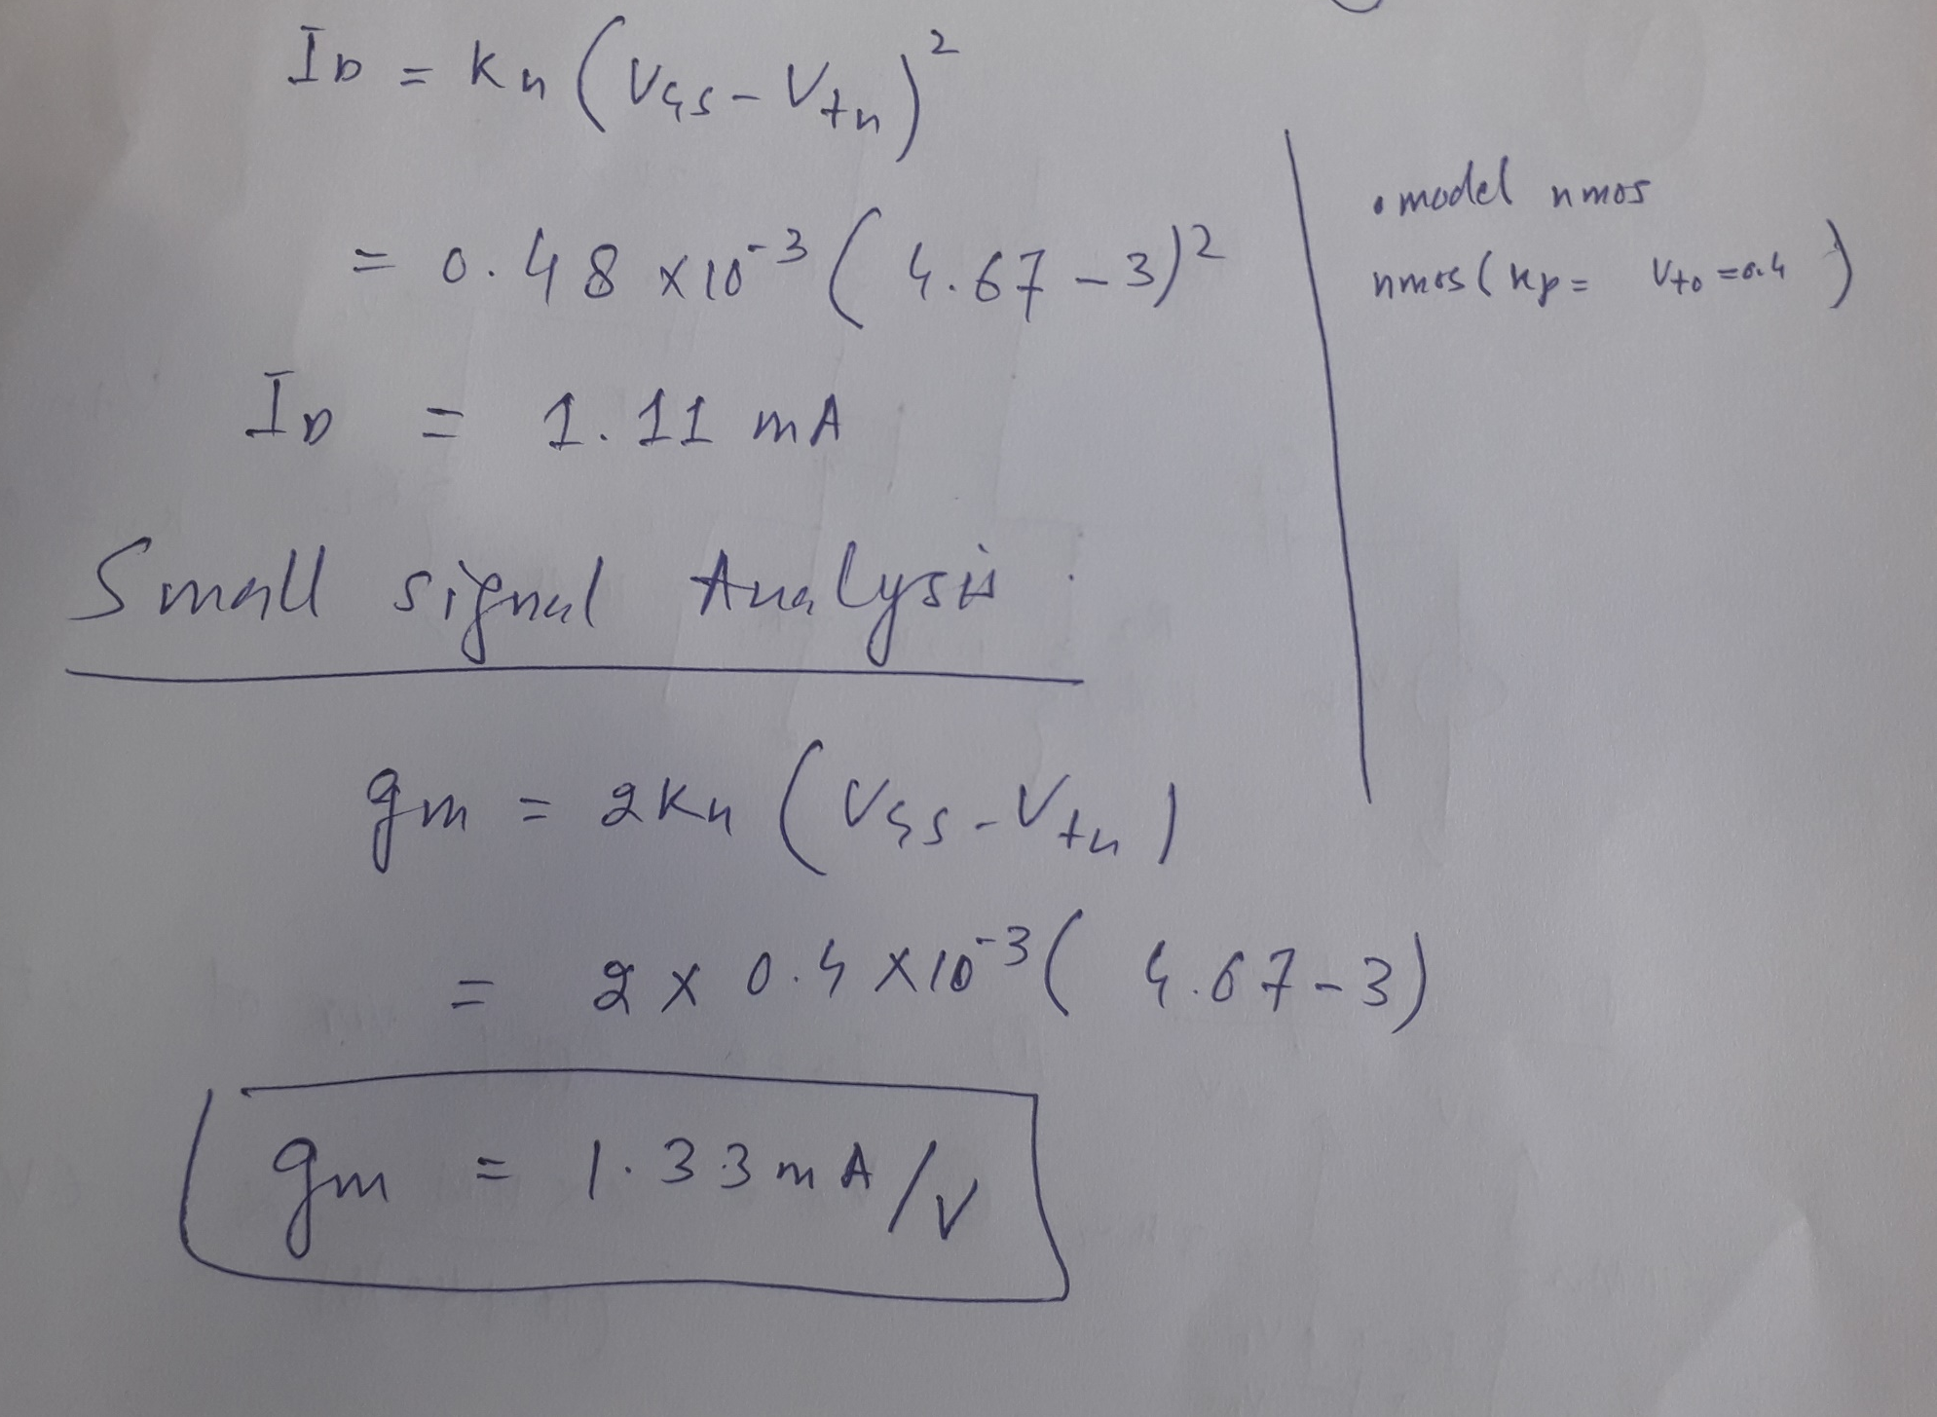

Slide 35
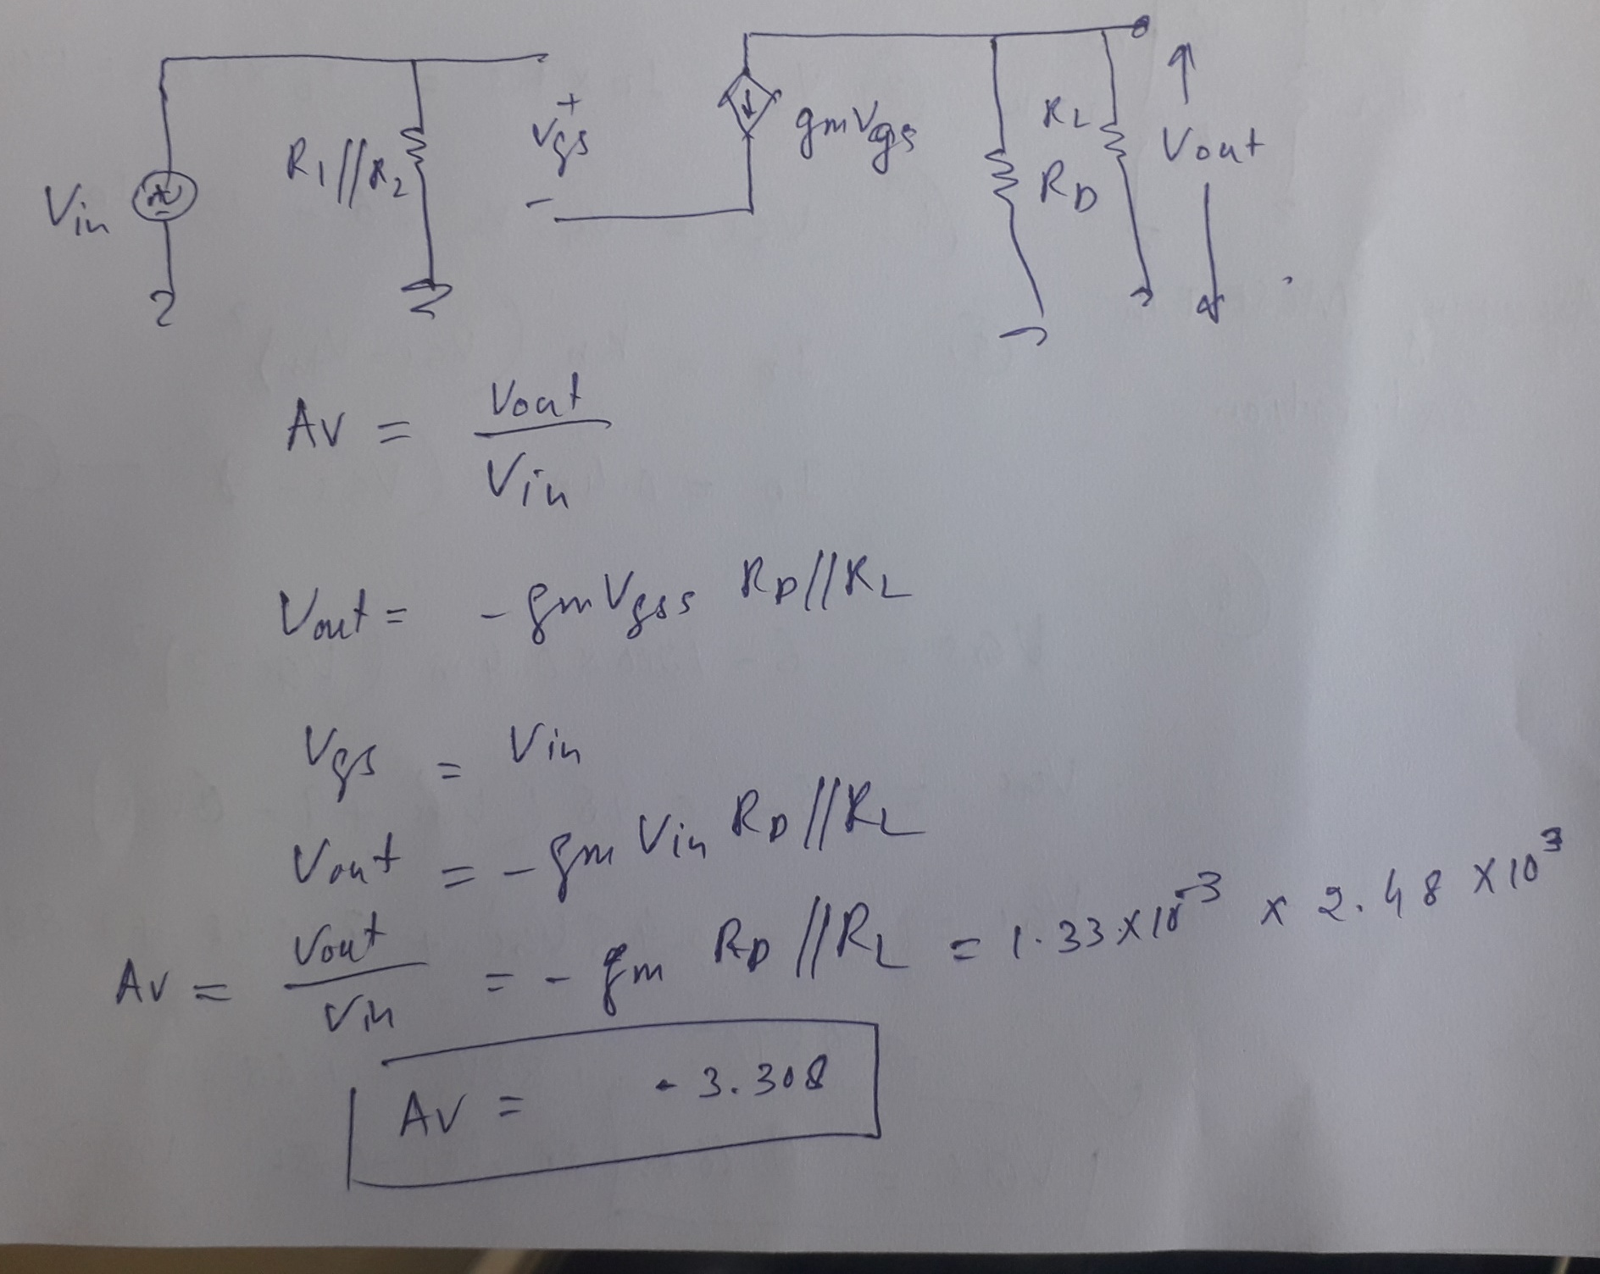

Slide 36
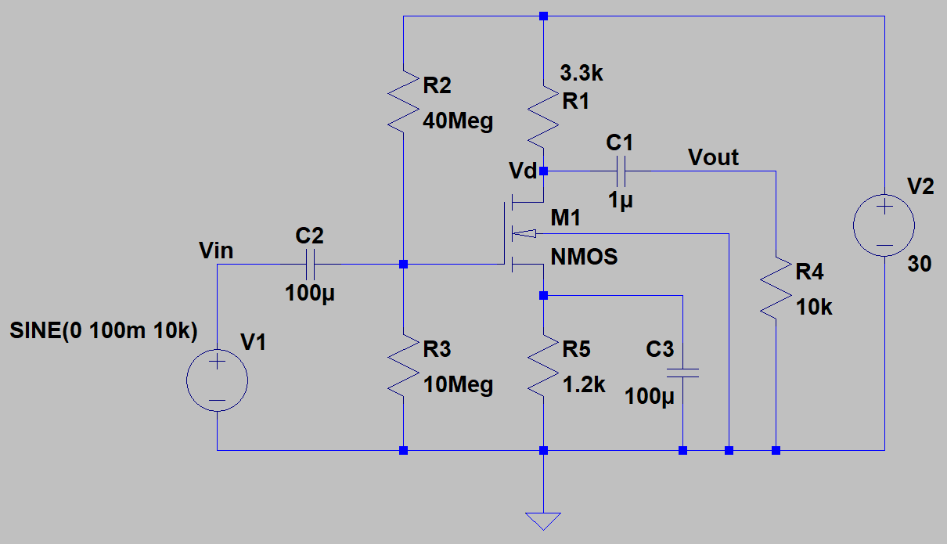
LTSpice Simulations

Slide 37
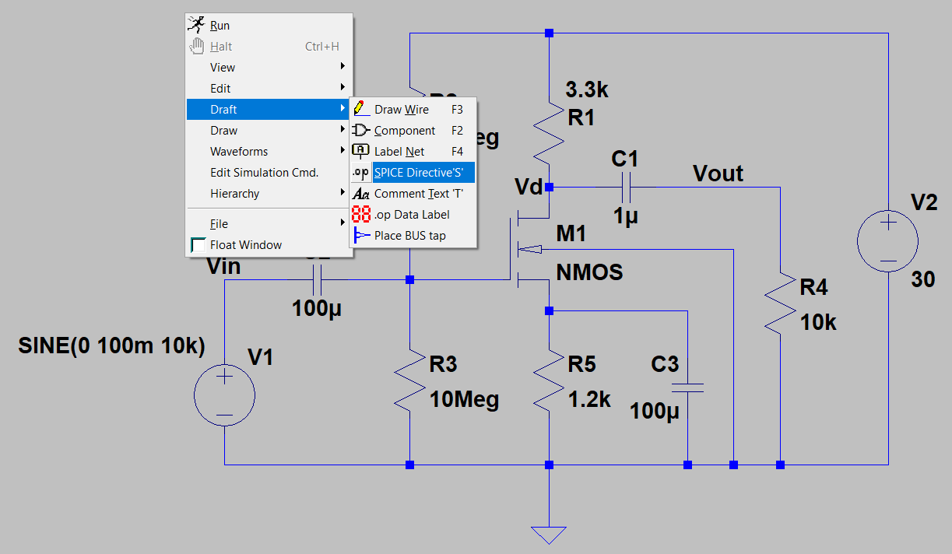
How to set NMOS parameters (Vtn, Kp)
Right click on the screen -> Draft-> Spice Directive

Slide 38
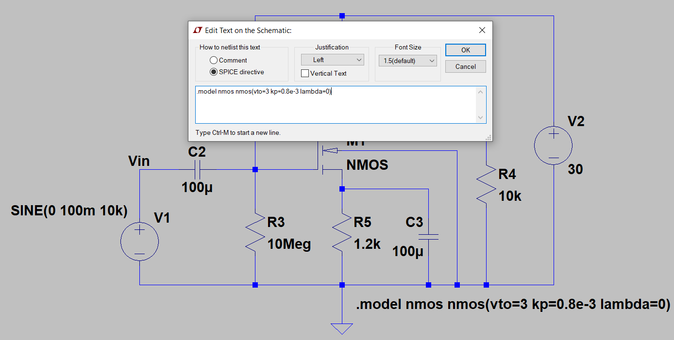
How to set NMOS parameters (Vtn, Kp)

Slide 39
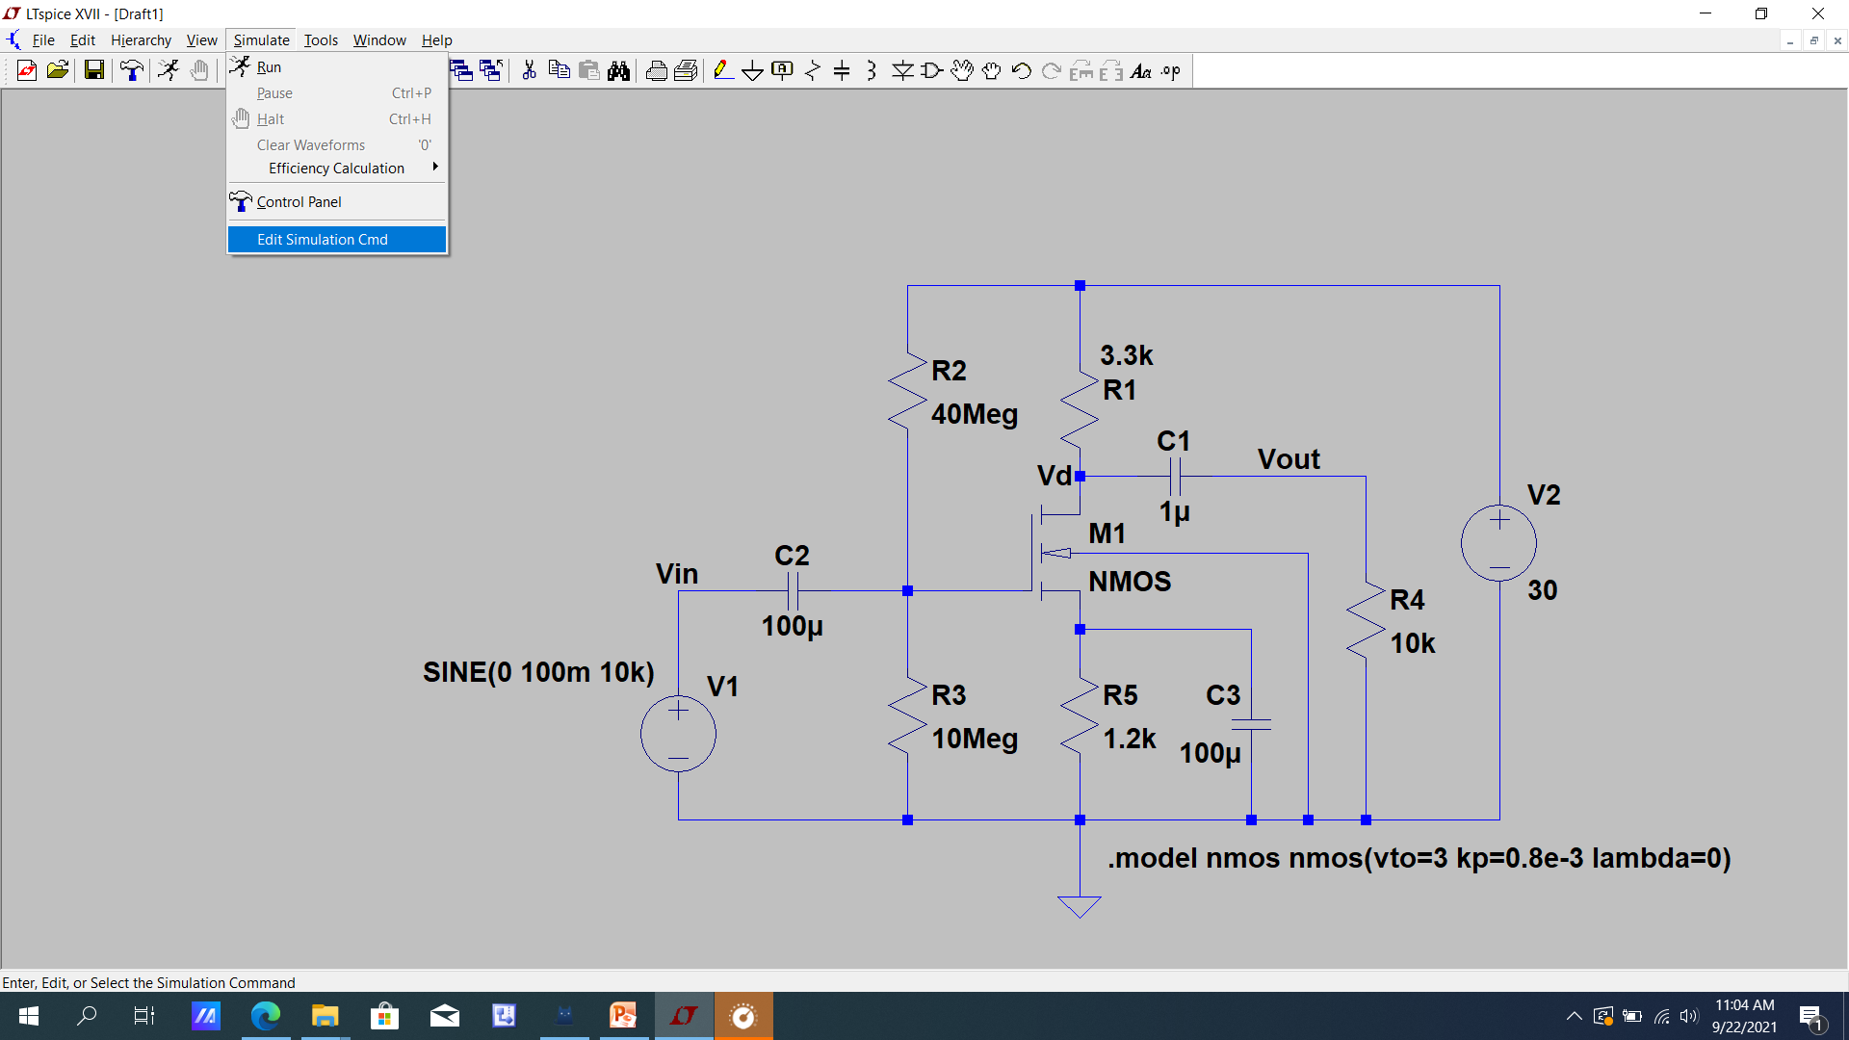
DC Analysis

Slide 40
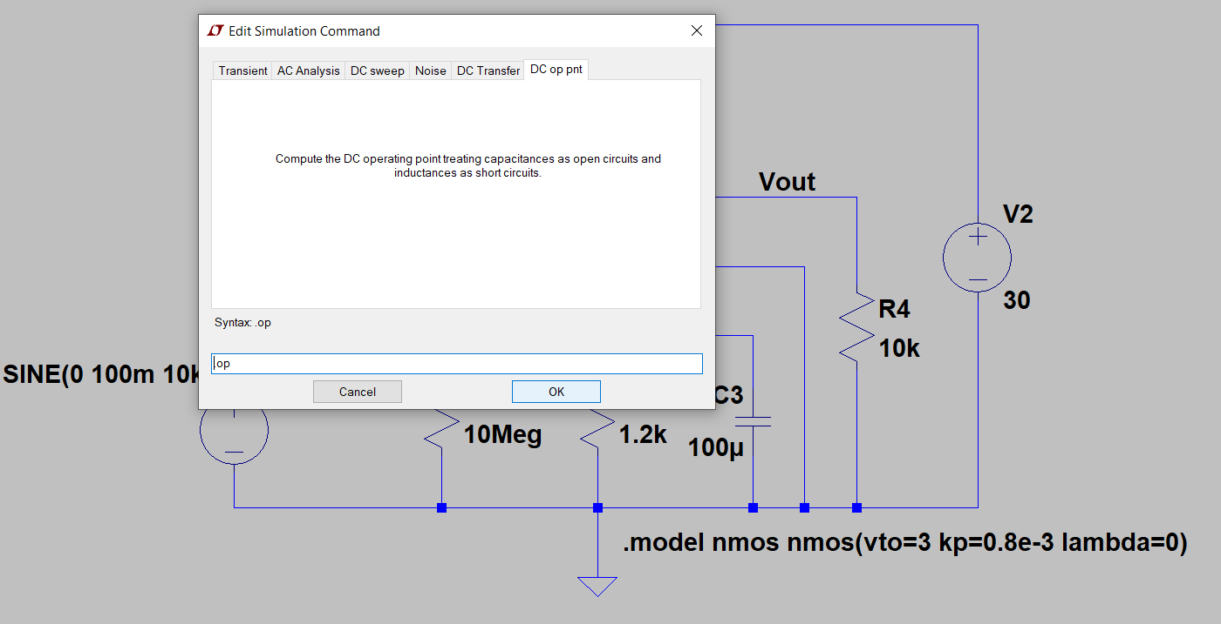
DC Analysis
Press OK

Slide 41
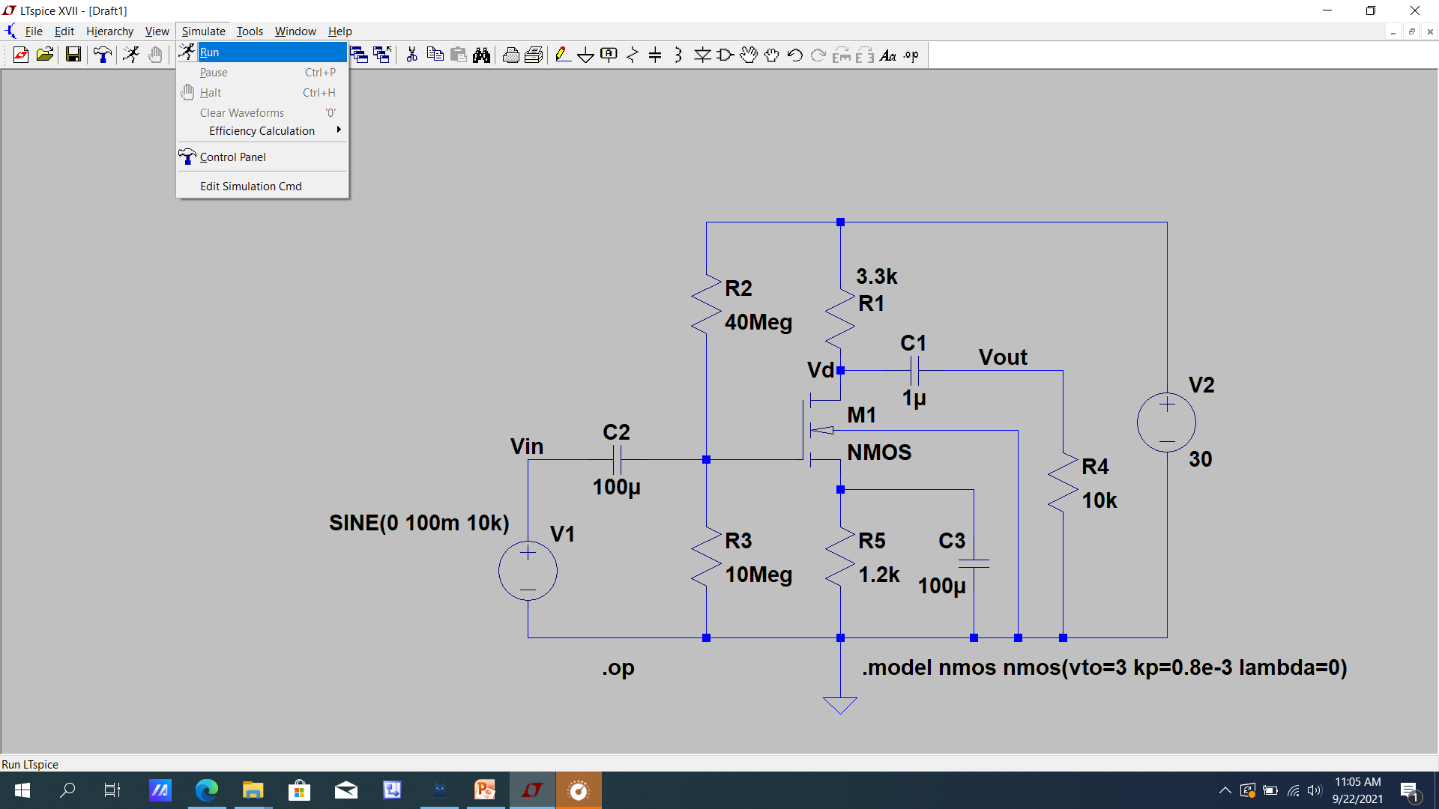
DC Analysis
Press Run from Simulate menu

Slide 42
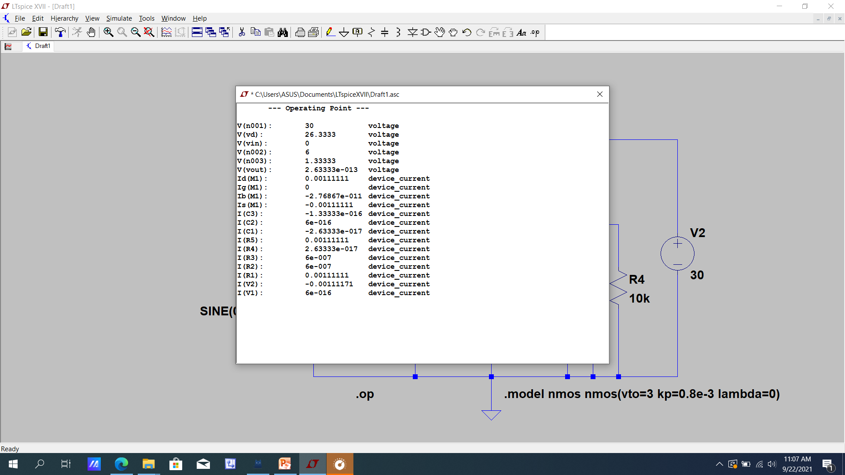
DC Analysis

Slide 43
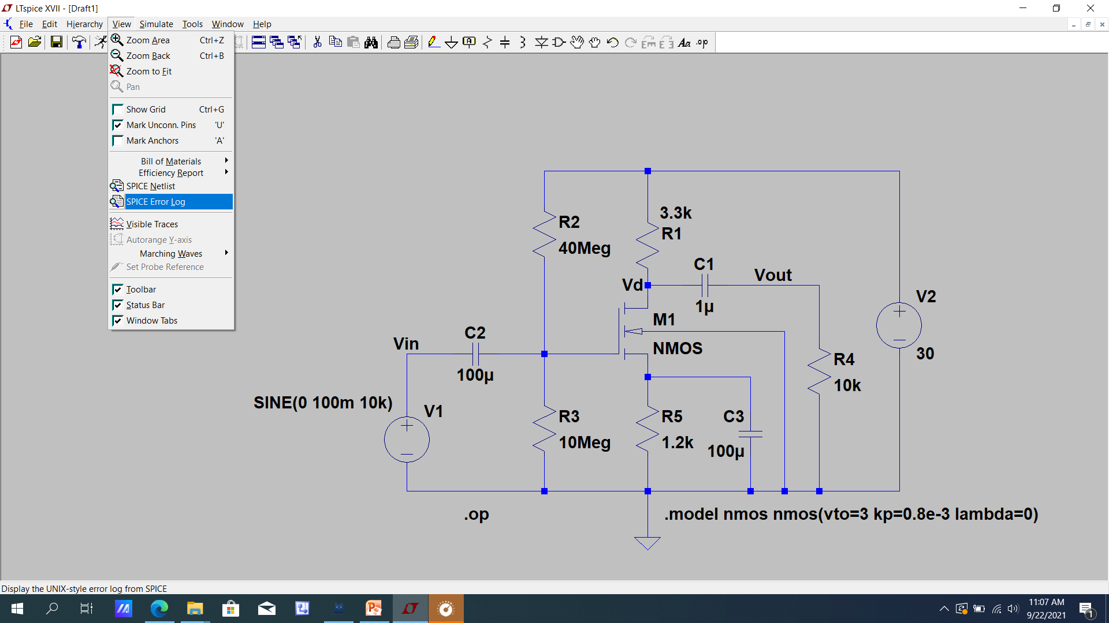
DC Analysis

Slide 44
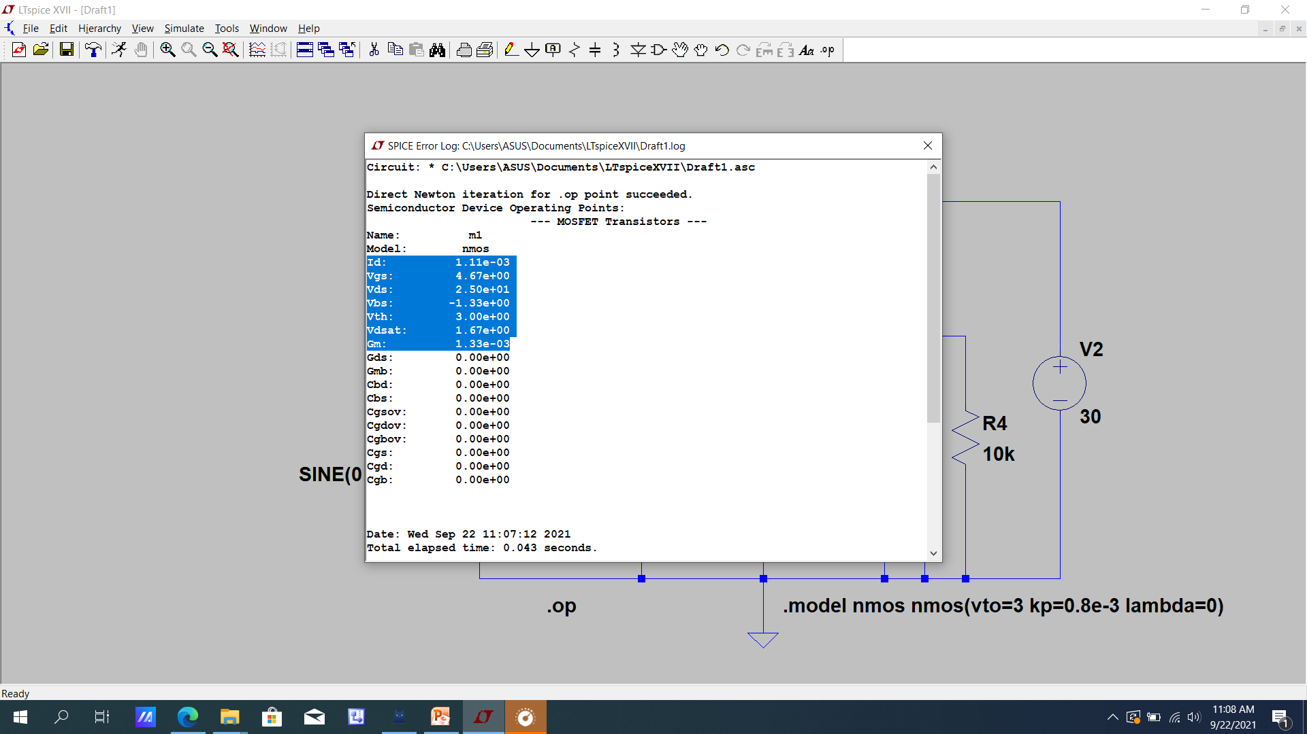
DC Analysis

Slide 45
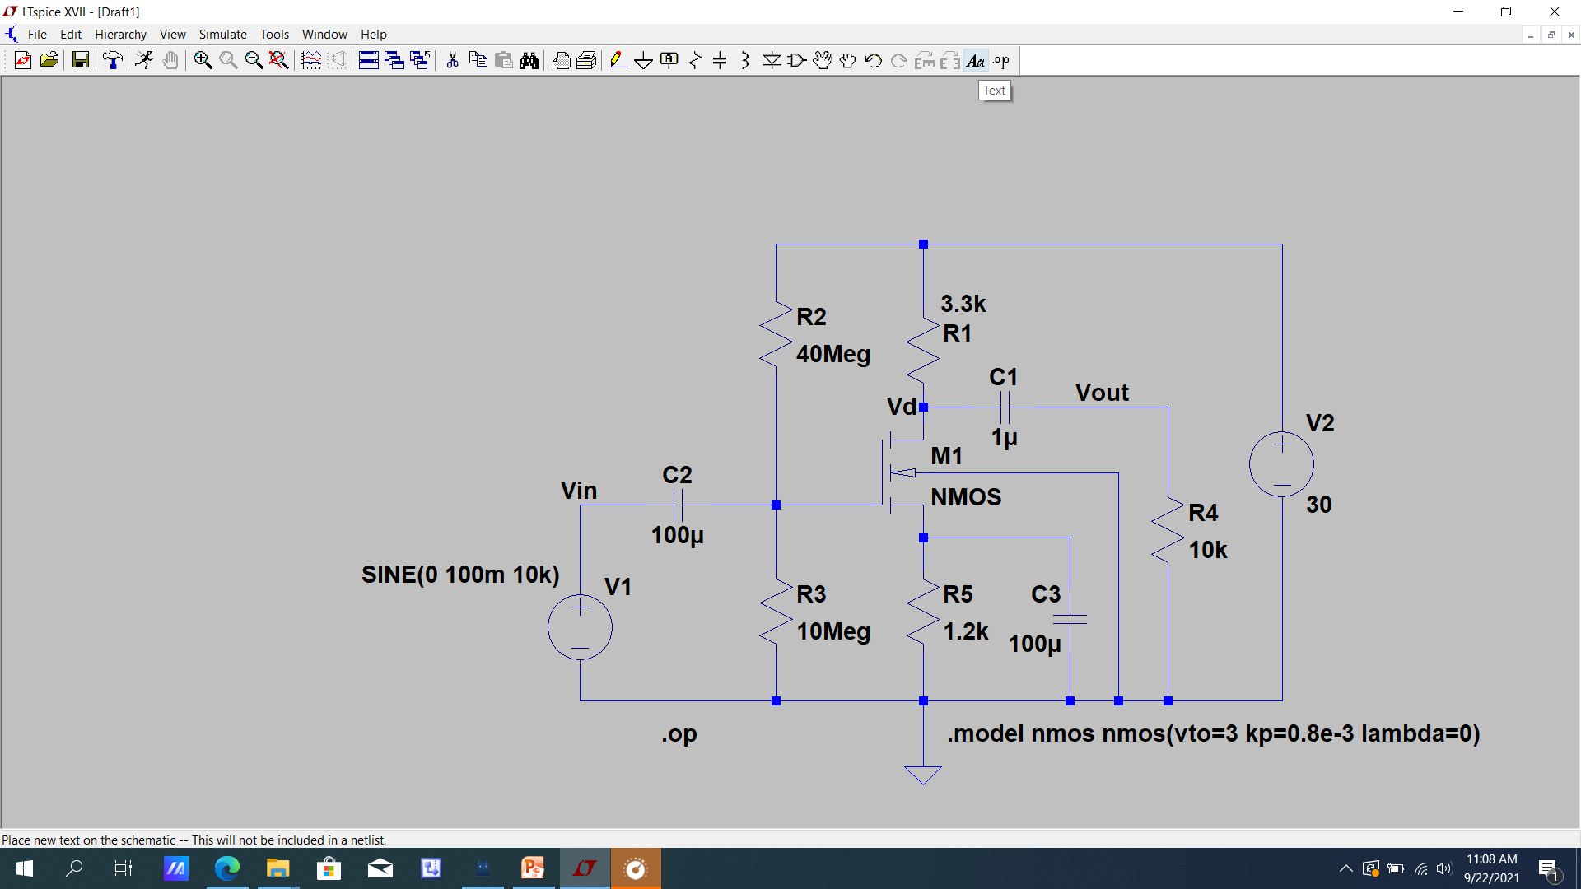
DC Analysis

Slide 46
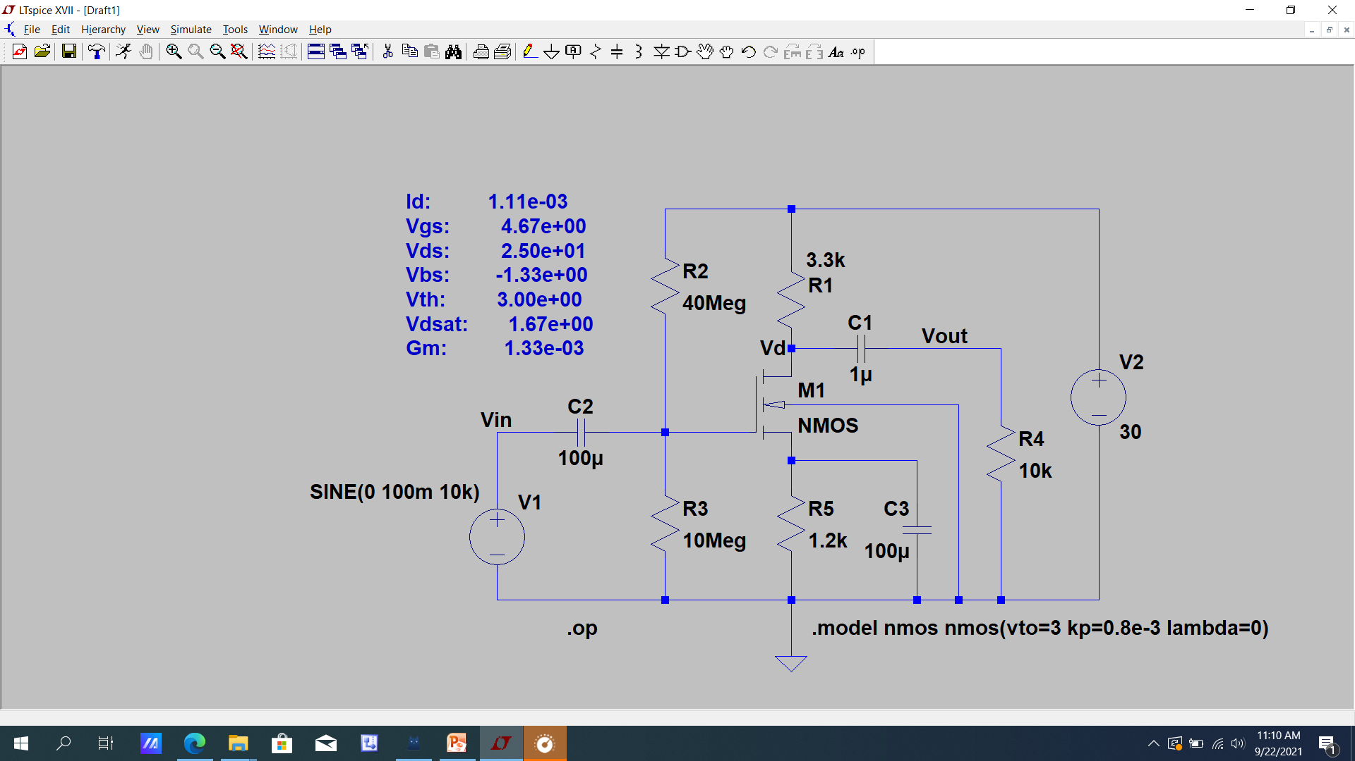
DC Analysis

Slide 47
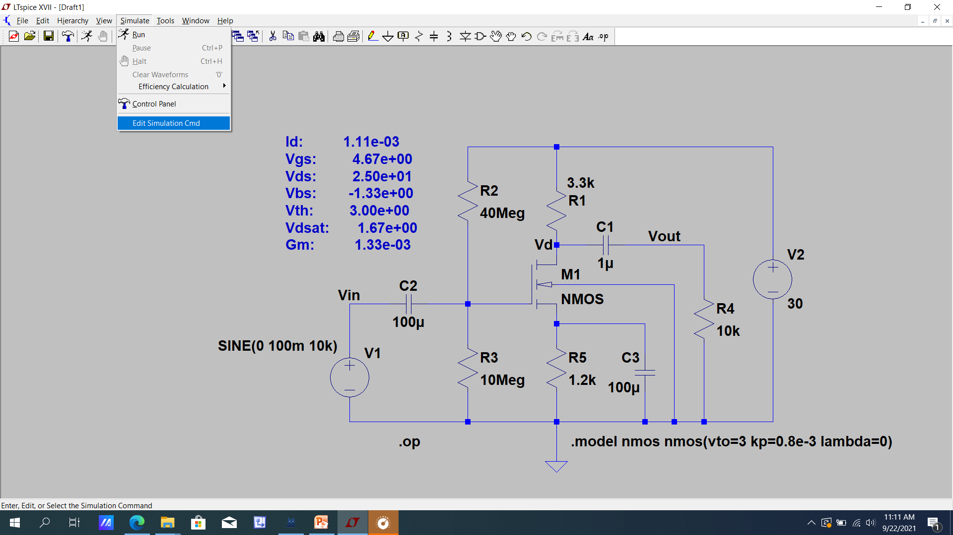
AC Analysis

Slide 48
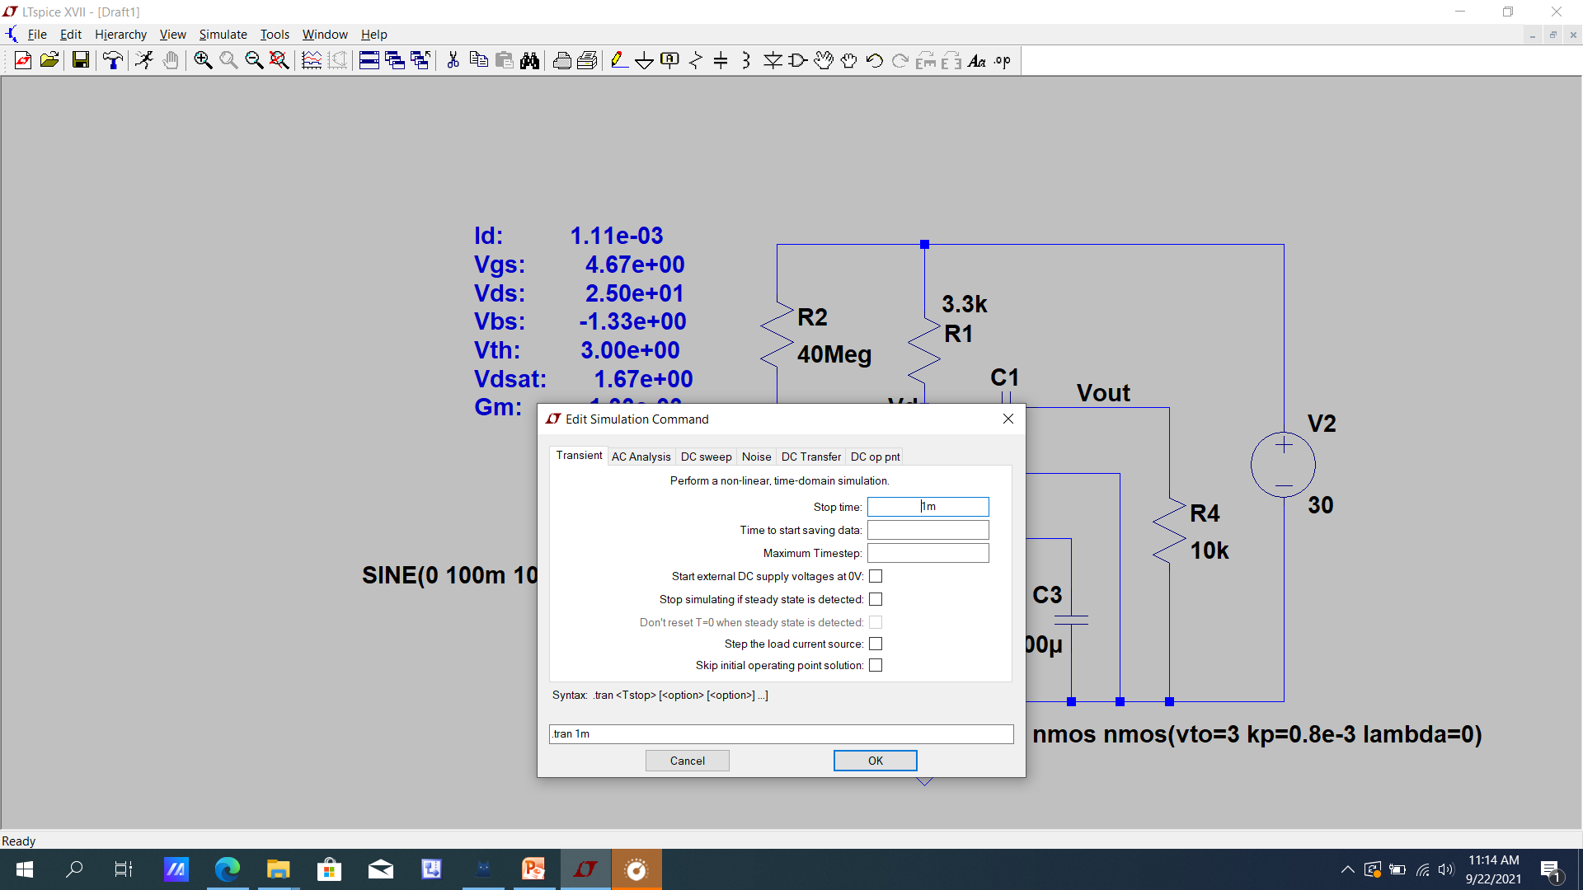
AC Analysis

Slide 49
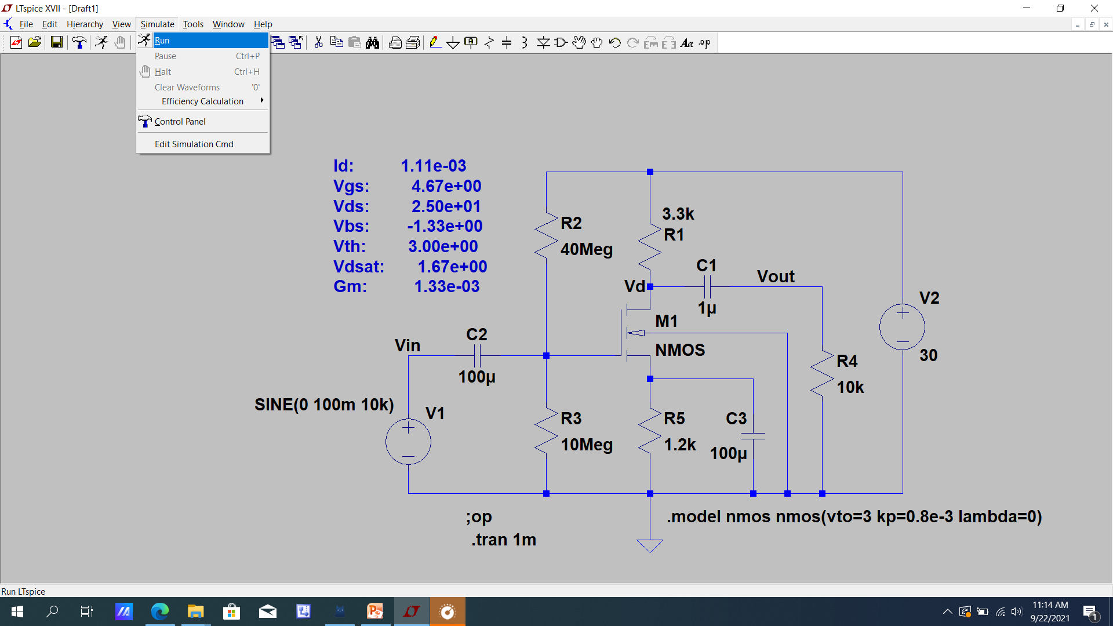
AC Analysis

Slide 50
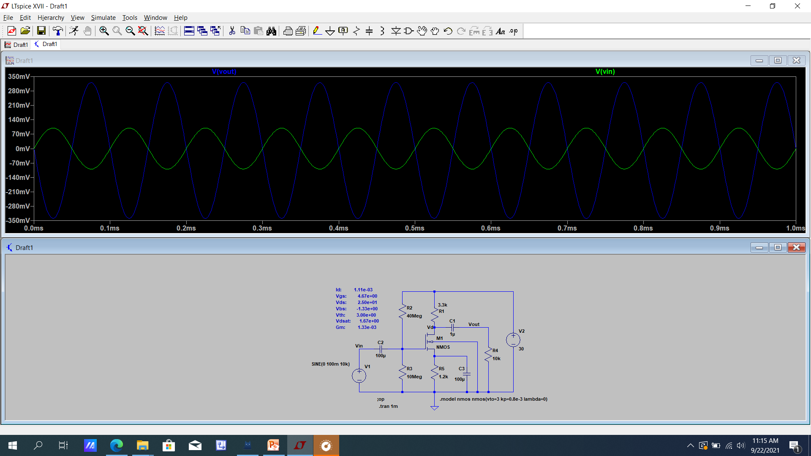
AC Analysis

Slide 51

Peak value of the Vin

Slide 52

Peak Value of Vout

Slide 53

Voltage gain

Slide 54

Voltage Gain

Slide 55

Voltage Gain

